Slide 1
Mahanalobis Distance
Dr. Pradeep Bilurkar
Notes:
This template can be used as a starter file for presenting training materials in a group setting.
Sections
Right-click on a slide to add sections. Sections can help to organize your slides or facilitate collaboration between multiple authors.
Notes
Use the Notes section for delivery notes or to provide additional details for the audience. View these notes in Presentation View during your presentation.
Keep in mind the font size (important for accessibility, visibility, videotaping, and online production)
Coordinated colors
Pay particular attention to the graphs, charts, and text boxes.
Consider that attendees will print in black and white or grayscale. Run a test print to make sure your colors work when printed in pure black and white and grayscale.
Graphics, tables, and graphs
Keep it simple: If possible, use consistent, non-distracting styles and colors.
Label all graphs and tables.

Slide 2
Mahanalobis Distance
Mahalanobis distances provide a powerful method of measuring how similar some set of conditions is to an ideal set of conditions, and can be very useful for identifying which regions in a landscape are most similar to some “ideal” landscape.
For example, in the field of wildlife biology we might define an “ideal” landscape as that which best fits the niche of some wildlife species. Through observation, we may find that a wildlife species typically occurs within a particular elevation range, on slopes of a particular steepness, and perhaps within a certain vegetation density. Using Mahalanobis distances, we can quantitatively describe the entire landscape in terms of how similar it is to the ideal elevation, slope and vegetation density of that animal.

Slide 3
Mahanalobis Distance
Moreover, Mahalanobis distances are based on both the mean and variance of the predictor variables, plus the covariance matrix of all the variables, and therefore take advantage of the covariance among variables. The region of constant Mahalanobis distance around the mean forms an ellipse in 2D space (i.e. when only 2 variables are measured), or an ellipsoid or hyperellipsoid when more variables are used.

Slide 4
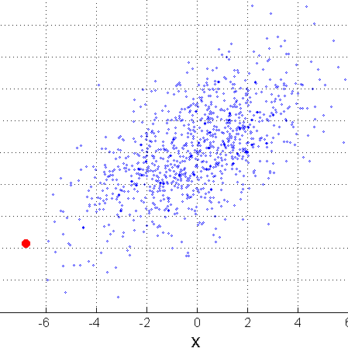
Mahalanobis Distance
Σ is the covariance matrix of the input data X
B
When the covariance matrix is identity
Matrix, the mahalanobis distance is the
same as the Euclidean distance.
Useful for detecting outliers.
Q: what is the shape of data when
covariance matrix is identity? Q: A is closer to P or B?
A
P
For red points, the Euclidean distance is 14.7, Mahalanobis distance is 6.

Slide 5
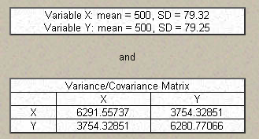
For example, suppose we took a single observation from a bivariate population with Variable X and Variable Y, and that our two variables had the following characteristics:

Slide 6
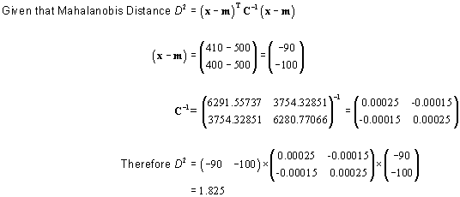
If, in our single observation, X = 410 and Y = 400, we would calculate the Mahalanobis distance for that single value as:
Therefore, our single observation would have a distance of 1.825 standardized
units from the mean (mean is at X = 500, Y = 500).

Slide 7
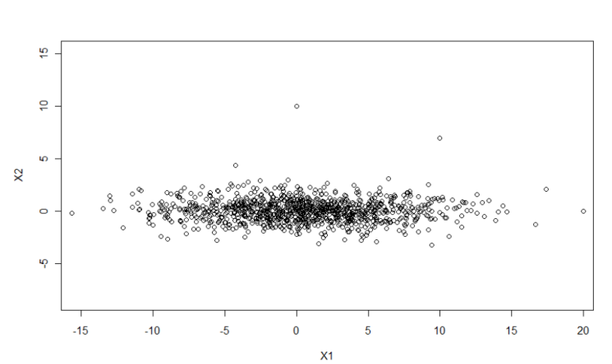

Mahanalobis Distance example

Slide 8
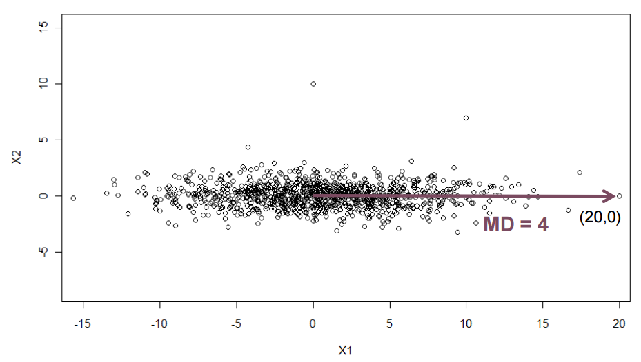


Mahanalobis Distance example

Slide 9
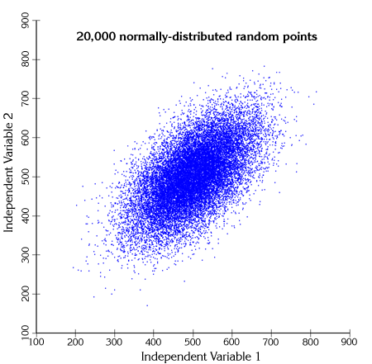
If we took many such observations, graphed them and colored them according to their Mahalanobis values, we can see the elliptical Mahalanobis regions come out. For example, the cloud of data points to the right are randomly generated from the bivariate population described above:

Slide 10
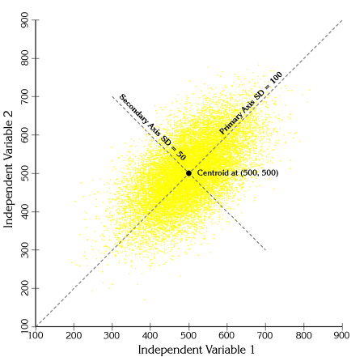

Slide 11
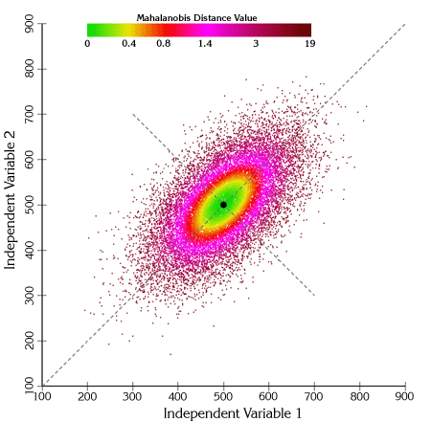
If we calculate Mahalanobis distances for each of these points and shade them according to their distance value, we see clear elliptical patterns emerge:

Slide 12
We can also draw actual ellipses at regions of constant Mahalanobis values
One interesting feature to note from this figure is that a Mahalanobis distance of 1 unit corresponds to 1 standard deviation along both primary axes of variance

Slide 13
Chi-Square P-values:
Mahalanobis distances are occasionally converted to Chi-square p-values for analysis (see Clark et al. 1993). When the predictor variables are normally distributed, the Mahalanobis distances do follow the Chi-square distribution with n-1 degrees of freedom (where n = # of habitat variables; 2 in the example above). However, Farber and Kadmon (2003) warn that wildlife habitat variables often fail to meet the assumption of normality. In cases where the predictor variables are not normally distributed, the conversion to Chi-square p-values serves to recode the Mahalanobis distances to a 0-1 scale. Mahalanobis distances themselves have no upper limit, so this rescaling may be convenient for some analyses.

Slide 14
In general, the p-value reflects the probability of seeing a Mahalanobis value as large or larger than the actual Mahalanobis value, assuming the vector of predictor values that produced that Mahalanobis value was sampled from a population with an ideal mean (i.e. equal to the vector of mean predictor variable values used to generate the Mahalanobis value). P-values close to 0 reflect high Mahalanobis distance values and are therefore very dissimilar to the ideal combination of predictor variables. P-values close to 1 reflect low Mahalanobis distances and are therefore very similar to the ideal combination of predictor variables. The closer the p-value is to 1, the more similar that combination of predictor values is to the ideal combination.

Slide 15
Applications to Landscape Analysis:
A nice feature of ArcView Spatial Analyst is that we can use actual grids in the Mahalanobis Distance equation rather than numbers, so we can input a vector of habitat grids in place of the vector of input values. We still need the vector of mean values and the covariance matrix, but Spatial Analyst will treat each of these values as an individual landscape-scale grid of that value, and therefore the mathematical functions in Spatial Analyst will work correctly and produce a final grid of Mahalanobis values. Due to a limitation in Spatial Analyst, however, we are limited to 8 input grids for this analysis. Spatial Analyst v. 9 is supposed to fix this limitation.
For example, suppose we have a grid of elevation values and a grid of slope values, and we are interested in identifying those regions on the landscape that have similar slopes and elevations to a mean slope and elevation preferred by some species of interest. Furthermore, we want to analyze the slope and elevations in combination so that if our species likes steep slopes at low elevations but shallow slopes at high elevations, then we won’t inadvertently select steep slopes at high elevations or shallow slopes at low elevations.

Slide 16
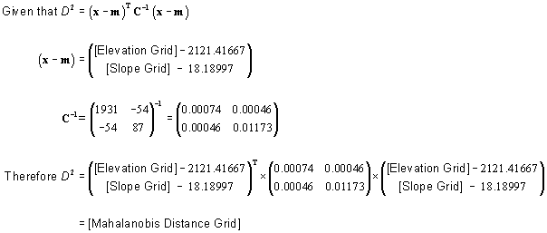

Slide 17
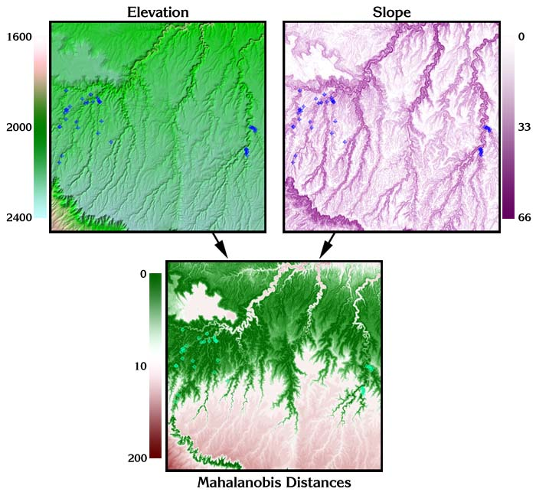

Slide 18
Additional Reading:
The author recommends Clark et al. (1993), Knick & Dyer (1997), and Farber & Kadmon (2002) for a few good papers illustrating the use of Mahalanobis distances in ecological applications. For anyone interested in the details of matrix algebra and computational/statistical algorithms, the author recommends Conover (1980), Neter et al. (1990), Golub and Van Loan (1996), Draper and Smith (1998), Meyer (2000) and Press et al. (2002).

Slide 19
The standard Gaussian distribution (with zero mean and unit variance) is often denoted with the Greek letter ϕ (phi). The alternative form of the Greek phi letter, φ, is also used quite often.
The normal distribution is also often denoted by N(μ, σ²). Thus when a random variable X is distributed normally with mean μ and variance σ², we write
If you think about any Gaussian distribution vs. the Standard Normal distribution, what is the difference? Center and scale based on central tendency (mean) and variation tendency (standard deviation). One is the coordinate transform of the other. Mahalanobis is that transform. It shows you what the world looks like if your distribution of interest was re-cast as a standard normal instead of a Gaussian.

